Slide 1

Suicides

Slide 2

Objective
Suicide is the 10th leading cause of death in the United States, taking the lives of approximately 47,000 Americans each year. Thus, it becomes a matter of concern that needs to be investigated.
Keeping in mind that anything can be resolved with the help of adequate support and lifestyle, the act of ending one's own life specifying the reasons for being depression, alcoholism, social reasons or any other mental illness in that matter is not a good idea. We can make a difference by making lives more livable for those who struggle to cope.
Through this study, I look forward to identifying the trends in suicidal rates by region, gender, age and ethnicity, and to relate these trends to the possible reasons that lead to the drastic decision that could enable us to curb the thinking at the very start.

Slide 3
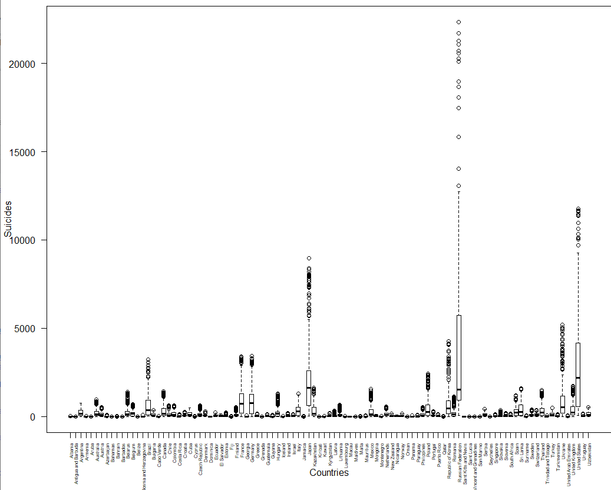
Exploratory Data Analysis
This is a country-wise representation of suicidal deaths per age group. The number of deaths vary largely depending on the country.
For ex., country like Albania has low suicidal death stats as compared to the other countries. One possible reason for this could be low population of the country.

Slide 4
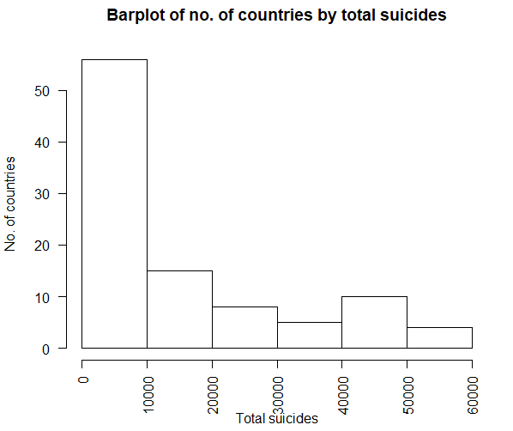
Number of Countries by Total Suicides
This bar chart represents total no. of countries that fall in the given range of suicidal cases.
As observed here, about 56 countries witness suicidal cases between 0-10000, 15 countries observe between 10000 to 20000 suicidal cases and only 4 countries witnessed more than 50000 suicide cases each year.

Slide 5
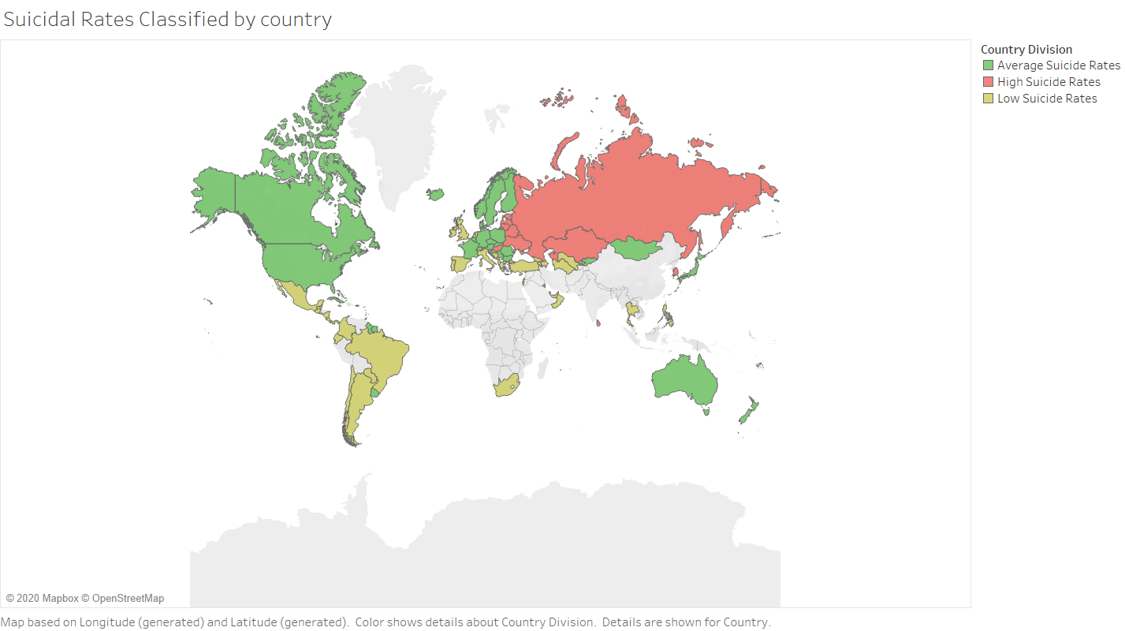
Suicidal Rated Classified by Country
These are the average suicidal rate per 100k population classified by country.
High suicidal rates are identified as more than 24 suicide cases per 100k population in that country (observed in the north-west Asian countries).
Low suicidal rates are identified as less than 12 suicides per 100k population and are denoted by the yellow color.

Slide 6
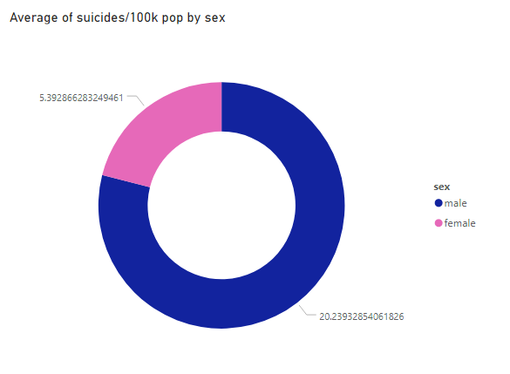
Males vs Females: Who are more prone to commit suicide?
It is observed that around 20 out of every 100,000 males commit suicide as opposed to only 5 in case of females.
We can assume that male have a higher tendency of committing suicide than female in general.

Slide 7
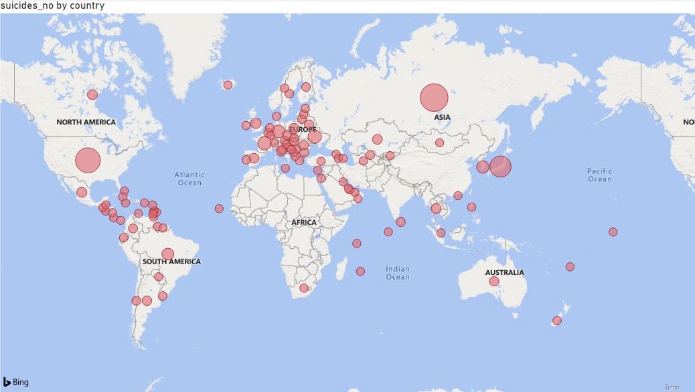
Country-wise Number of Suicide Cases
Size of circles represents the number of cases in the country
Bigger circle means greater number of suicidal cases in that country
Russia, United States and Japan are the three countries with maximum number of cases.

Slide 8
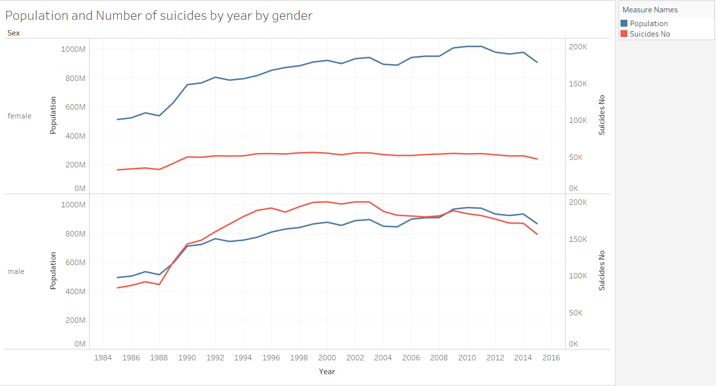
Does increase in population have the same effect on both genders?
For males, the graph for number of suicides committed seems to be very similar to that of the male population.
With increase in population there is increase in the number of male suicidal rates.
No such pattern is observed in case of females
The suicidal numbers for females look almost constant over time irrespective of its population.

Slide 9
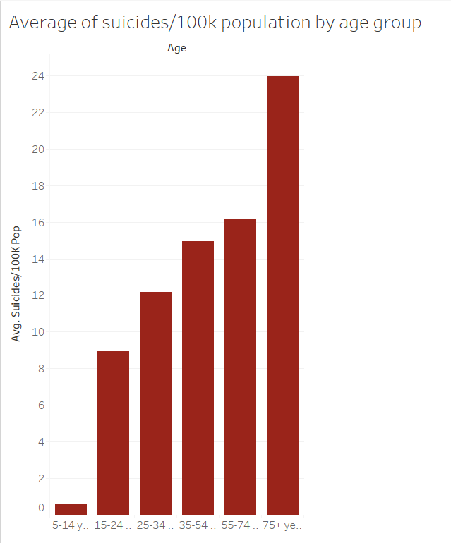
Average suicides by Age group
Average number of suicide cases are per 100k population classified by age
People above the age of 75 years are most prone to commit suicide(highlighted in the bar chart) as compared to the other age groups.
There is a possibility that as a person grows older, the more he/she comes across the harsh realities of life and looses the will to live.

Slide 10
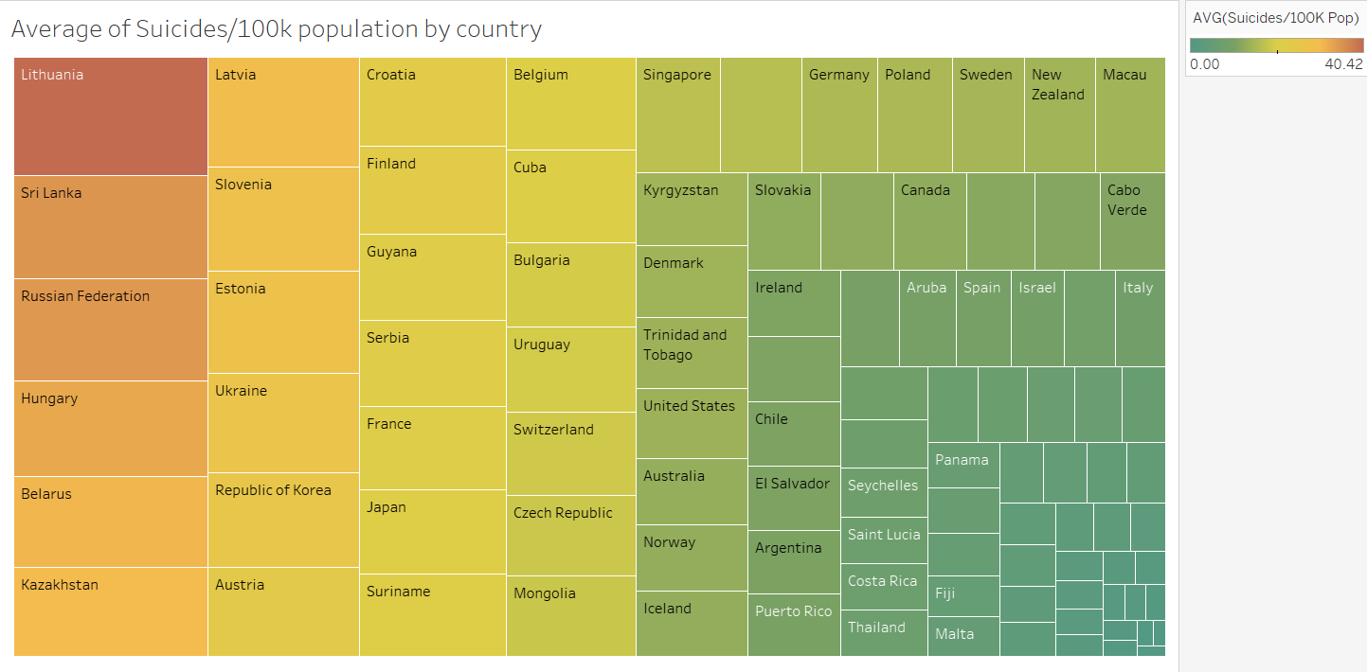
Average Suicides by Country
Lithuania tops the list with an average of around 40 suicide cases per 100 k population followed by Sri Lanka and Russia.
Countries in the bottom right corner of the tree map like Turkey, Oman and Jamaica have the lowest average number of suicide cases per 100k population.

Slide 11
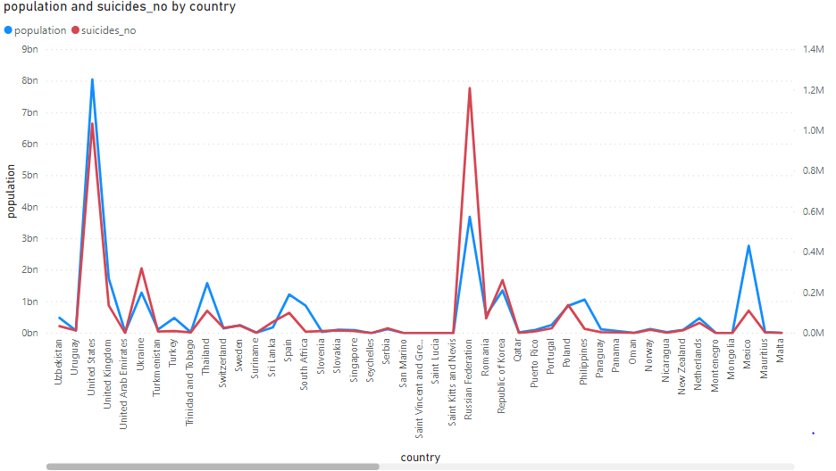
Country-wise population and suicide numbers
Country’s population plays a major factor contributing to the number of suicidal cases in that country.
A general trend of more suicide cases in the country are registered if the population of the country itself is more.
For this reason, there are greater number of cases in countries like United States and Russia.

Slide 12
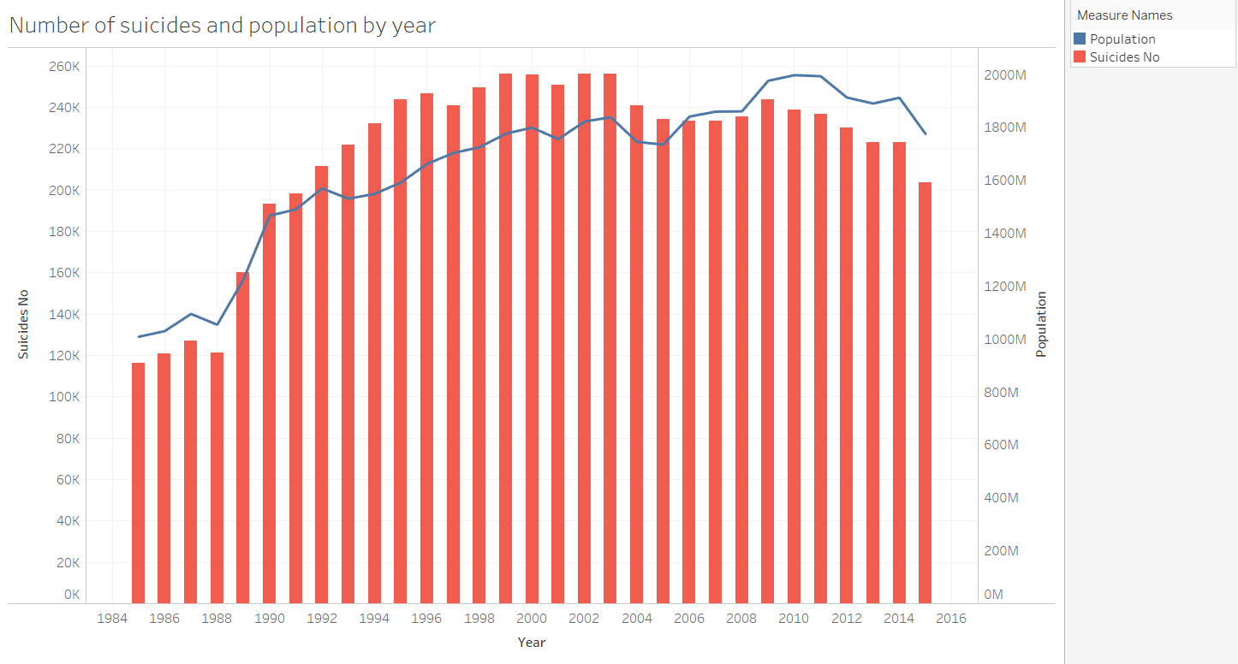
Does Population affect Number of Suicides?
The bars show the total number of suicides by year and the line represents the population over that period.
The number of suicides seem to go hand in hand with population throughout the years.
A significant increase in the number of cases is observed with increase in population till year 2002 while the number of cases drop in year 2015 with decrease in population

Slide 13

Takeaways
Country’s population plays a major factor contributing to the number of suicidal cases in that country
Lithuania has the most number of suicide cases per 100k population
Russia tops the list for most number of total suicide cases with more than 1,200,000 cases during the period
People above the age of 75 years are most prone to commit suicide as compared to the other age groups
Male have a higher tendency of committing suicide than female in general

Slide 14
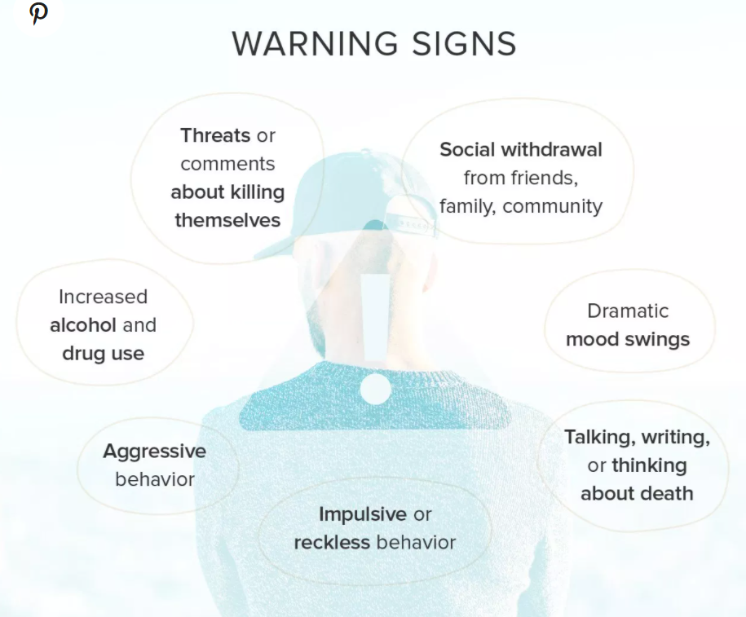
Warning signs that someone may attempt suicide

Slide 15
3-Step Process To Be Followed
Suicidal thoughts and behaviors should be considered a psychiatric emergency.
01
If you or someone you know is exhibiting either, you should seek immediate assistance from a healthcare provider.
02
If you’re concerned and don’t know what to do, you can get help from a crisis or suicide prevention hotline.
03

Slide 16
Thank You

